Slide 1
Object Oriented Programming: Class, Object, Constructor & Destructor
Course Code: CSC1102 &1103
Course Title: Introduction to Programming
Dept. of Computer Science
Faculty of Science and Technology
Lecturer No: | 9 | Week No: | 7 (2X1.5) | Semester:
Lecturer: | Name & email

Slide 2
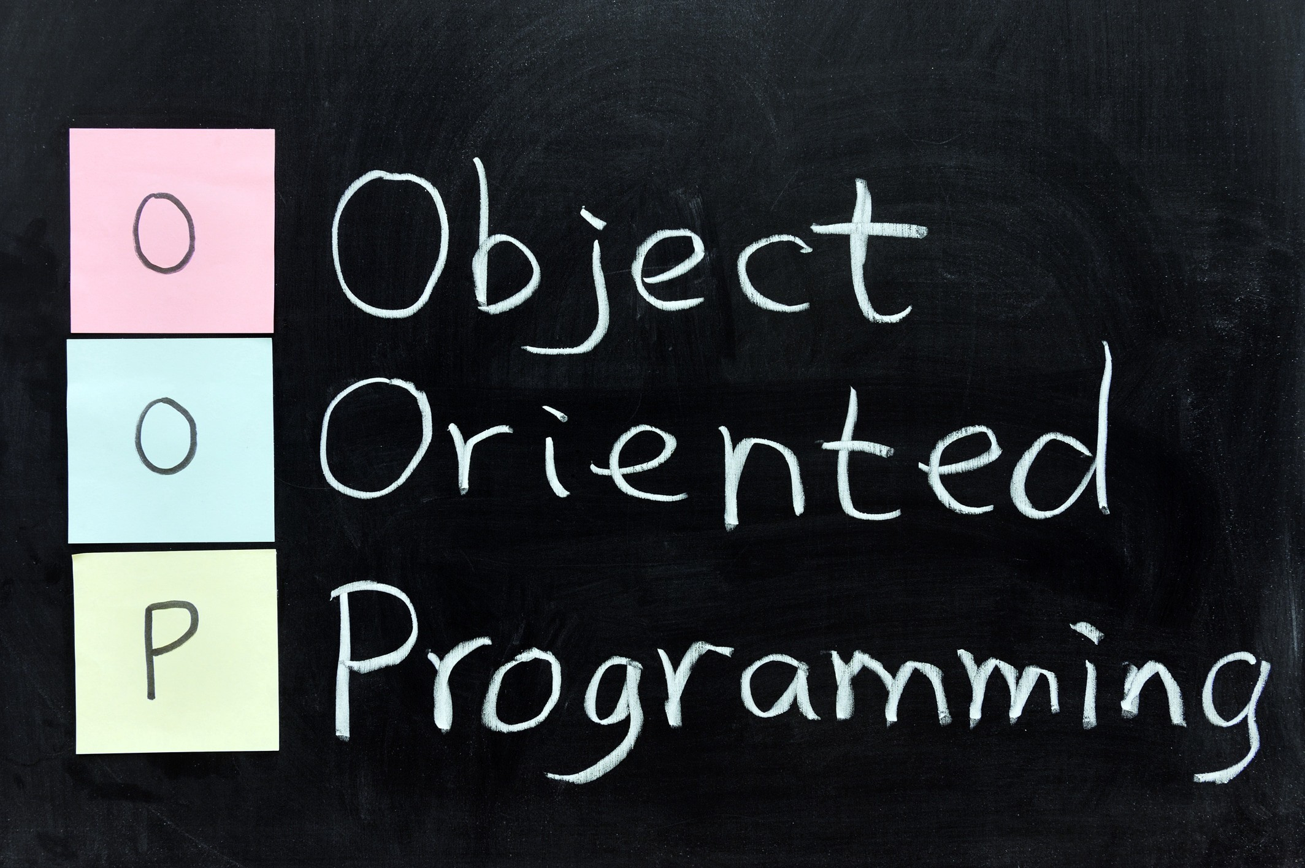
Object Oriented Programming
An approach that provides a way of modularizing programs by creating partitioned memory area for both data & functions that can be used as templates for creating copies of such modules on demand.

Slide 3
OOP stands for Object-Oriented Programming
Procedural programming is about writing procedures or functions that perform operations on the data, while object-oriented programming is about creating objects that contain both data and functions.
Object-oriented programming has several advantages over procedural programming:
OOP is faster and easier to execute
OOP provides a clear structure for the programs
OOP helps to keep the C++ code DRY "Don't Repeat Yourself", and makes the code easier to maintain, modify and debug
OOP makes it possible to create full reusable applications with less code and shorter development time

Slide 4
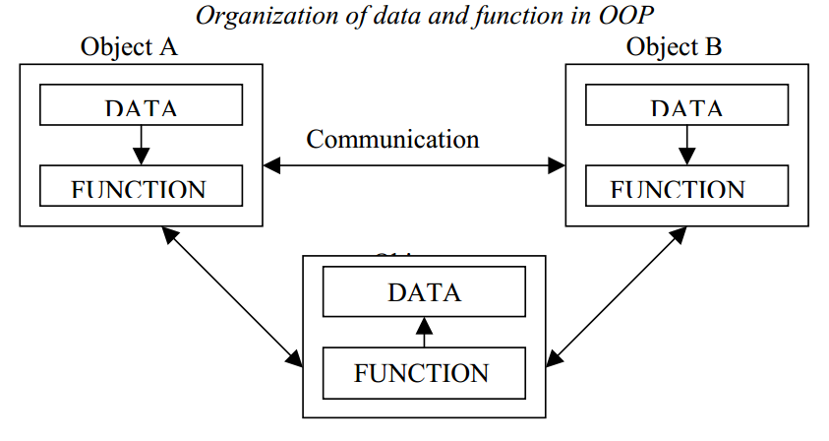
OOP: Object oriented programming
The major motivating factor in the invention of object-oriented approach is to remove some of the flaws encountered in the procedural approach. OOP treats data as a critical element in the program development and does not allow it to flow freely around the system.
It ties data more closely to the function that operate on it, and protects it from accidental modification from outside function. OOP allows decomposition of a problem into a number of entities called objects and then builds data and function around these objects.
The organization of data and function in object-oriented programs is shown in figure. The data of an object can be accessed only by the function associated with that object. However, function of one object can access the function of other objects.

Slide 5
OOP vs. POP
OOP | POP
Emphasis is on data rather than procedure. Follows bottom up approach in program design. | Emphasis is on doing things (algorithms).
Programs are divided into what are known as objects. | Large programs are divided into smaller programs known as functions.
Data structures are designed such that they characterize the objects | Most of the functions share global data.
Functions that operate on the data of an object are ties together in the data structure | Functions transform data from one form to another
Data is hidden and cannot be accessed by external function. | Data move openly around the system from function to function.
Follows bottom up approach in program design. | Employs top-down approach in program design.

Slide 6
Benefits of OOP
OOP offers several benefits to both the program designer and the user. Object Orientation contributes to the solution of many problems associated with the development and quality of software products. The new technology promises greater programmer productivity, better quality of software and lesser maintenance cost. The principal advantages are:
Through inheritance, we can eliminate redundant code extend the use of existing Classes.
We can build programs from the standard working modules that communicate with one another, rather than having to start writing the code from scratch. This leads to saving of development time and higher productivity.
The principle of data hiding helps the programmer to build secure program that can not be invaded by code in other parts of a programs.
It is possible to have multiple instances of an object to co-exist without any interference.

Slide 7
Benefits of OOP (Continue)
It is possible to map object in the problem domain to those in the program.
It is easy to partition the work in a project based on objects.
The data-centered design approach enables us to capture more detail of a model can implemental form.
Object-oriented system can be easily upgraded from small to large system.
Message passing techniques for communication between objects makes to interface descriptions with external systems much simpler.

Slide 8
Basic concept of OOP
It is necessary to understand some of the basic concepts used extensively in object-oriented programming. These include:
• Objects
• Classes
• Data abstraction and encapsulation
• Inheritance
• Polymorphism

Slide 9
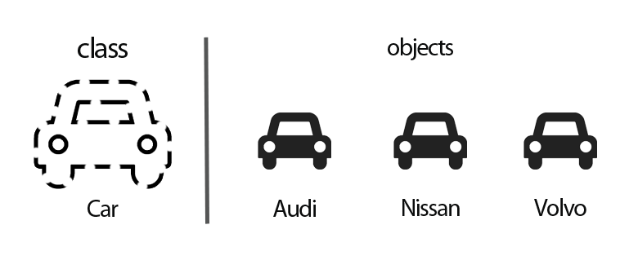
What is an object
Objects are the basic run time entities in an object-oriented system. They may represent a person, a place, a bank account, a table of data or any item that the program has to handle.
They may also represent user-defined data such as vectors, time and lists.
Programming problem is analyzed in term of objects and the nature of communication between them.
Program objects should be chosen such that they match closely with the real-world objects.
Objects take up space in the memory and have an associated address like a record in Pascal, or a structure in c.

Slide 10
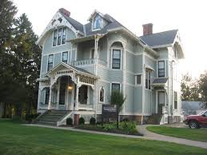
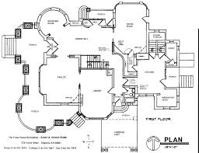
What is a Class
A class is the “Blue Print” of an object.
For example, a class that represents a bank account might contain one member function to deposit money to an account, another to withdraw money from an account and a third to inquire what the account’s current balance is.
A class is similar in concept to a car’s engineering drawings, which house the design of an accelerator pedal, steering wheel, and so on.
Class is a way of binding data & associated functions together.

Slide 11
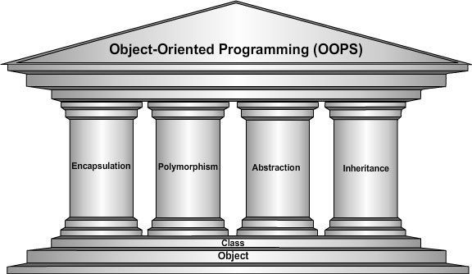
Pillars of OOP

